Slide 1

教你如何使用Pokémon GO API
Weihung @ TADSG 2016.08.27

Slide 2


Android Developer 讀書會顧問兼講師
英諾奧茲股份有限公司 資深工程師
Android develop over 5 years
Yes123、Shopping99、金仁寶醫療級 APP、龍巖櫻悅繽紛、勤業眾信會計師事務所、Flyfit、康福搬家、iFound、Zavio IP Cam、遠傳 MVPN…

Slide 3
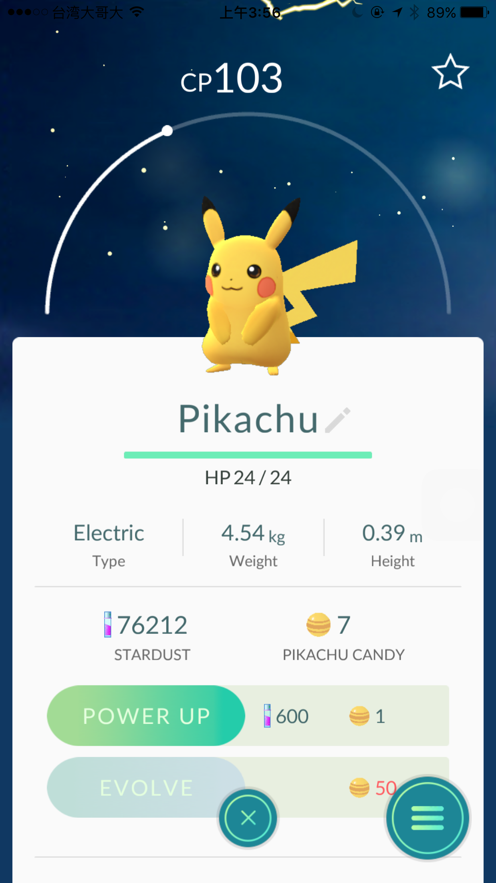
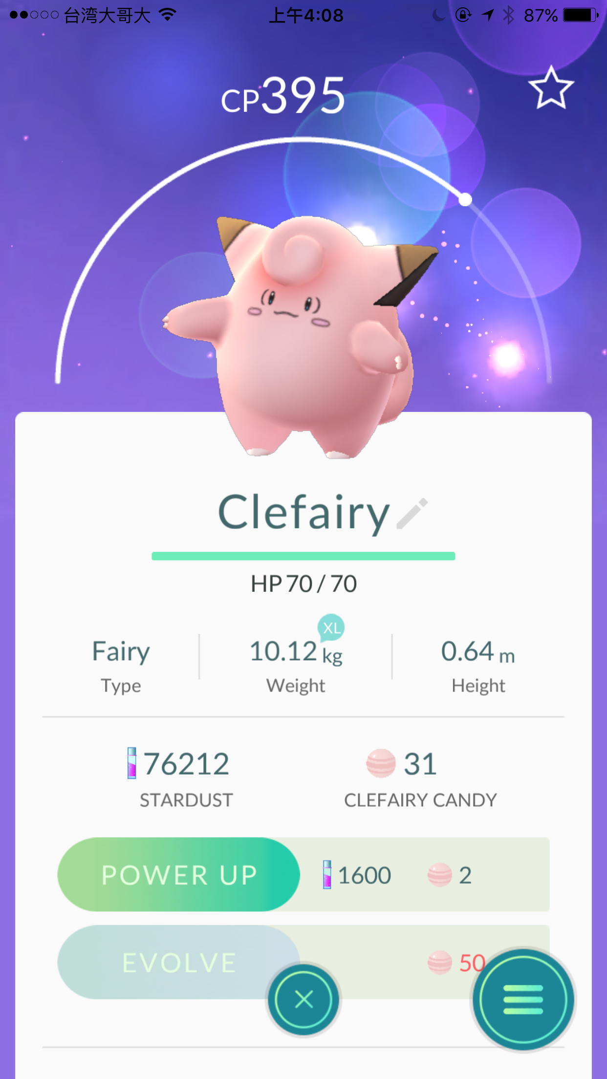

Slide 4
Skype
Connecting with skype
Accept invite
Send message to skype
Receive message form skype

Slide 5
Pokémon GO API
Connecting via Google account
Connecting via PTC account
Set device info
Set location
Find pokémon & get pokémon cp
Catch pokémon
Get pokémon IV

Slide 6
Skype Library
Use Skype4J https://github.com/samczsun/Skype4J
Download 0.2.0 https://ci.samczsun.com/job/Skype4J/

Slide 7
Skype Login
skype = new SkypeBuilder(USERNAME, PASSWORD)
.withAllResources()
.withExceptionHandler(new ErrorHandler() {
@Override
public void handle(ErrorSource arg0, Throwable arg1, boolean arg2) {
}
})
.build();
skype.login(); skype.subscribe();

Slide 8
Skype Register Listener
skype.getEventDispatcher() .registerListener( new Listener() { @EventHandler
public void onContact(ContactRequestEvent e) {
e.getRequest().accept();
Chat chat = skype.getOrLoadChat("8:" + e.getRequest().getSender().getUsername()); chat.sendMessage("Hi!");
}
@EventHandler public void onMessage(MessageEvent e) { Chat chat = e.getChat(); ChatMessage message = e.getMessage(); String content = message.getContent().asPlaintext());
}
}

Slide 9
Skype Chat Id
19:xxxxxxx@thread.skype is group chat
8:xxxxxxx is contact chat

Slide 10
Skype
RUN & TEST

Slide 11
Pokémon GO API Library
PokeGOAPI-Java
https://github.com/Grover-c13/PokeGOAPI-Java
compile 'com.pokegoapi:PokeGOAPI-library:0.4.0'

Slide 12
Pokémon GO Device Info
Set Device info deviceInfo = new DeviceInfo(); deviceInfo.setAndroidBoardName(Build.BOARD); deviceInfo.setAndroidBootloader(Build.BOOTLOADER); deviceInfo.setDeviceBrand(Build.BRAND); deviceInfo.setDeviceId(Build.SERIAL); deviceInfo.setDeviceModel(Build.ID); deviceInfo.setDeviceModelBoot(Build.HARDWARE); deviceInfo.setDeviceModelIdentifier(Build.HOST); deviceInfo.setFirmwareBrand(Build.HOST); deviceInfo.setFirmwareFingerprint(Build.FINGERPRINT); deviceInfo.setFirmwareTags(Build.TAGS); deviceInfo.setFirmwareType(Build.TYPE); deviceInfo.setHardwareManufacturer(Build.MANUFACTURER); deviceInfo.setHardwareModel(Build.DEVICE);

Slide 13
Pokémon GO Google Login
Goto google web
Input username & password
Press accept
Copy auth. code
Pass auth code to API

Slide 14
Pokémon GO Google Login
OkHttpClient http = new OkHttpClient();
GoogleUserCredentialProvider provider;
try{
provider = new GoogleUserCredentialProvider(http); provider.login(authcode); go = new PokemonGo(provider, http);
go.setDeviceInfo(deviceInfo); } catch (LoginFailedException | RemoteServerException | AsyncPokemonGoException e) {
// Code error
}

Slide 15
Pokémon GO PTC Login
Input username & password
Pass username & password to API

Slide 16
Pokémon GO PTC Login
OkHttpClient http = new OkHttpClient();
PtcCredentialProvider provider;
try{
provider = new PtcCredentialProvider(http, username, password);
go = new PokemonGo(provider, http);
go.setDeviceInfo(deviceInfo); } catch (LoginFailedException | RemoteServerException | AsyncPokemonGoException e) {
// Code error
}

Slide 17
Pokémon GO Set Location
go.setLocation(latitude, longitude, altitude);
map = go.getMap();

Slide 18
Pokémon GO Find & Get CP
List<CatchablePokemon> catchablePokemons = map.getCatchablePokemon(); EncounterResult encounterResult = catchablePokemon.encounterPokemon(); encounterResult.getPokemonData().getCP();
mapObjects objects = map.getMapObjects(); List<PokeStop> stops = objects.getPokeStops(); stop.loot();

Slide 19
Pokémon GO Catch Pokémon
go.getInventories().getBag().getItem(ItemIdOuterClass.ItemId.ITEM_POKE_BALL); ITEM_POKE_BALL ITEM_GREATE_BALL ITEM_ULTRA_BALL ITEM_MASTER_BALL ITEM_RAZZ_BERRY
CatchResult result = pokemon.catchPokemon(); pokemon.catchPokemonWithRazzBerry();

Slide 20
Pokémon GO Get IV
Refresh data: go.getInventories().updateInventories();
get Pokebank Pokebank bank = go.getInventories().getPokebank();
get Pokemons in poke bank List<Pokemon> pokemons = bank.getPokemons();

Slide 21
Pokémon GO Get IV
get Pokemon values CP: pokemon.getCp() Max CP: pokemon.getMaxCp() Absolute Max CP: pokemon.getAbsoluteMaxCp() IV: pokemon.getIvRatio() * 100 Level: pokemon.getLevel() HP: pokemon.getStamina() / pokemon.getMaxStamina()/pokemon.getIndividualStamina() ATK: pokemon.getIndividualAttack()/pokemon.getBattlesAttacked() DEF: pokemon.getIndividualDefense()/pokemon.getBattlesDefense()

Slide 22
Q & A

